Slide 1
Song Analysis
Bhuvana Pravallika

Slide 2
Problem Statement
This internship project aims to conduct a comprehensive analysis of YouTube songs data using Power BI.
The dataset contains key attributes such as video ID, channel title, title, description, tags, published date,
view count, like count, favorite count, comment count, video duration, video definition, and caption
details. The goal is to utilize Power BI to create insightful visualizations and reports that provide a deeper
understanding of YouTube songs' performance, popularity, and user engagement. The analysis aims to
uncover trends, preferences, and patterns in the data to aid content creators and stakeholders in
optimizing their YouTube song content.

Slide 3
Dataset Description
1. video_id: Unique identifier for each YouTube video.
2. channelTitle: Title of the YouTube channel publishing the song.
3. title: Title of the YouTube song video.
4. description: Description provided for the YouTube song video.
5. tags: Tags associated with the YouTube song video.
6. publishedAt: Date and time when the YouTube song video was published.
7. viewCount: Number of views received by the YouTube song video.
8. likeCount: Number of likes received by the YouTube song video.
9. favoriteCount: Number of times the YouTube song video has been marked as a favorite.
10. commentCount: Number of comments posted on the YouTube song video.
11. duration: Duration of the YouTube song video.
12. definition: Video definition or quality (e.g., HD, SD).
13. caption: Availability of captions for the YouTube song video.

Slide 4
Project objectives
1. Data Cleaning and Preparation:
- Clean and preprocess the dataset, handling missing values or outliers.
- Convert relevant columns to appropriate data types.
2. Exploratory Data Analysis (EDA):
- Explore patterns and distributions in view counts, like counts, and comments.
- Identify trends in the popularity and engagement of YouTube song videos.
3. Content and Channel Analysis:
- Analyze the distribution of videos across different channels.
- Identify popular tags and their correlation with view counts.

Slide 5

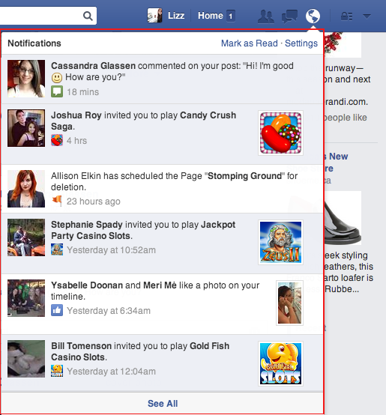

4. Temporal Trends:
- Explore how YouTube song video metrics vary over time.
- Identify peak publishing times and their impact on engagement.
5. User Engagement Insights:
- Investigate relationships between likes, comments, and views.
- Identify factors influencing user engagement with YouTube song videos.
viewers
User Engagement
Analysis
This Photo by Unknown Author is licensed under CC BY-SA

Slide 6
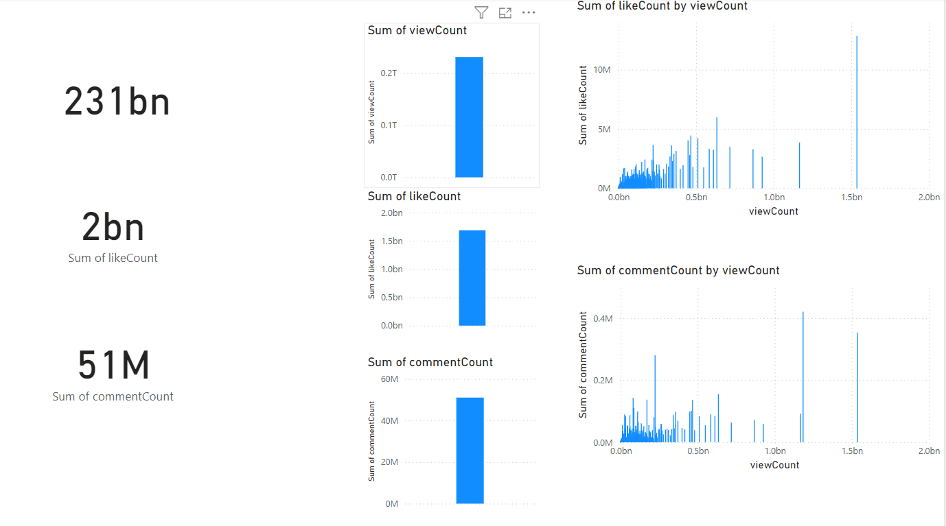
Exploratory Data Analysis

Slide 7
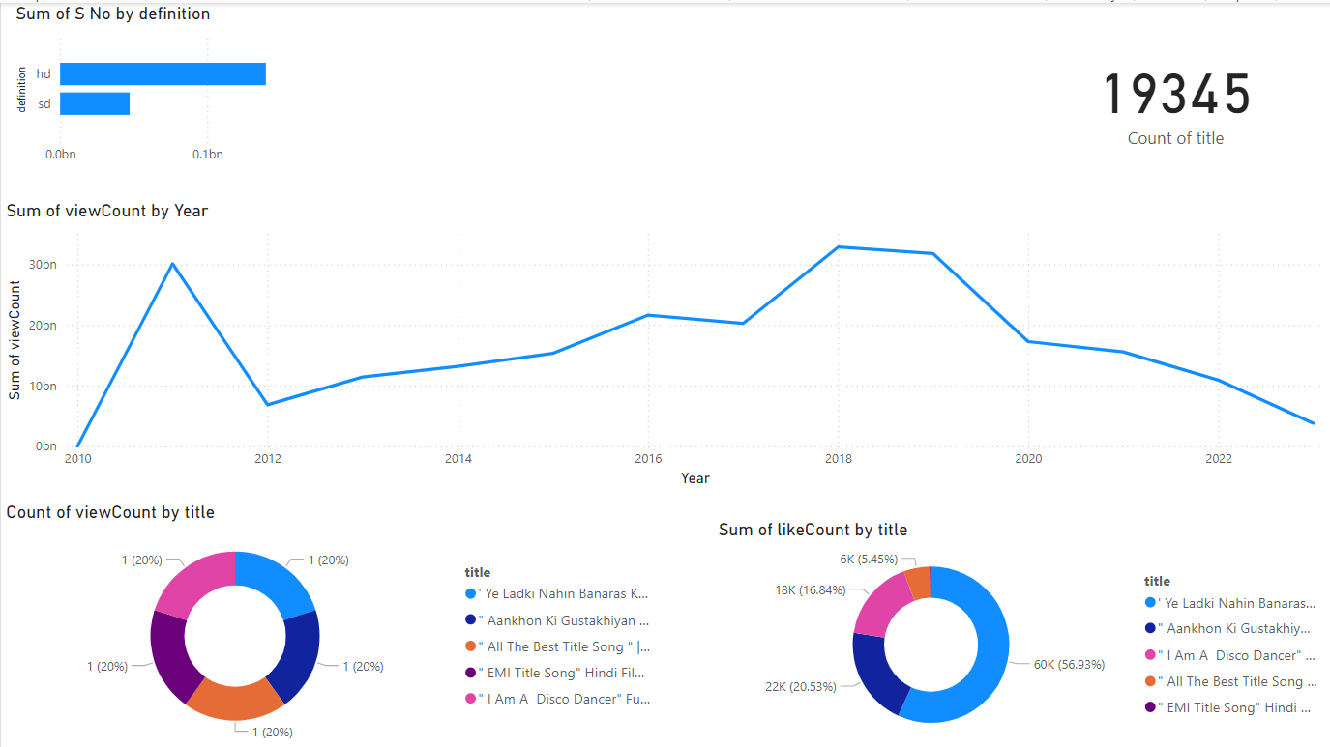
Trends and insights dashboard

Slide 8
Recommendations for enhancing youtube song video Performance
Optimize Titles and Descriptions with relevant keywords and engaging phrases. Use Popular and Relevant Tags to increase visibility.
Ensure High Video Quality by using HD and professional editing.
Include Captions for accessibility and SEO benefits.
Adjust Video Duration based on viewer retention analysis.
Publish During Peak Times and maintain a consistent schedule.
Encourage Viewer Engagement with calls to action and active comment responses.
Promote Videos on Social Media and collaborate with other creators.
Regularly Monitor Performance Metrics and adapt strategies accordingly. Diversify Content with different types and formats to keep the audience engaged,

Slide 9
Thank you
Bhuvana Pravallika

